Slide 1

September 1, 2026

Slide 2
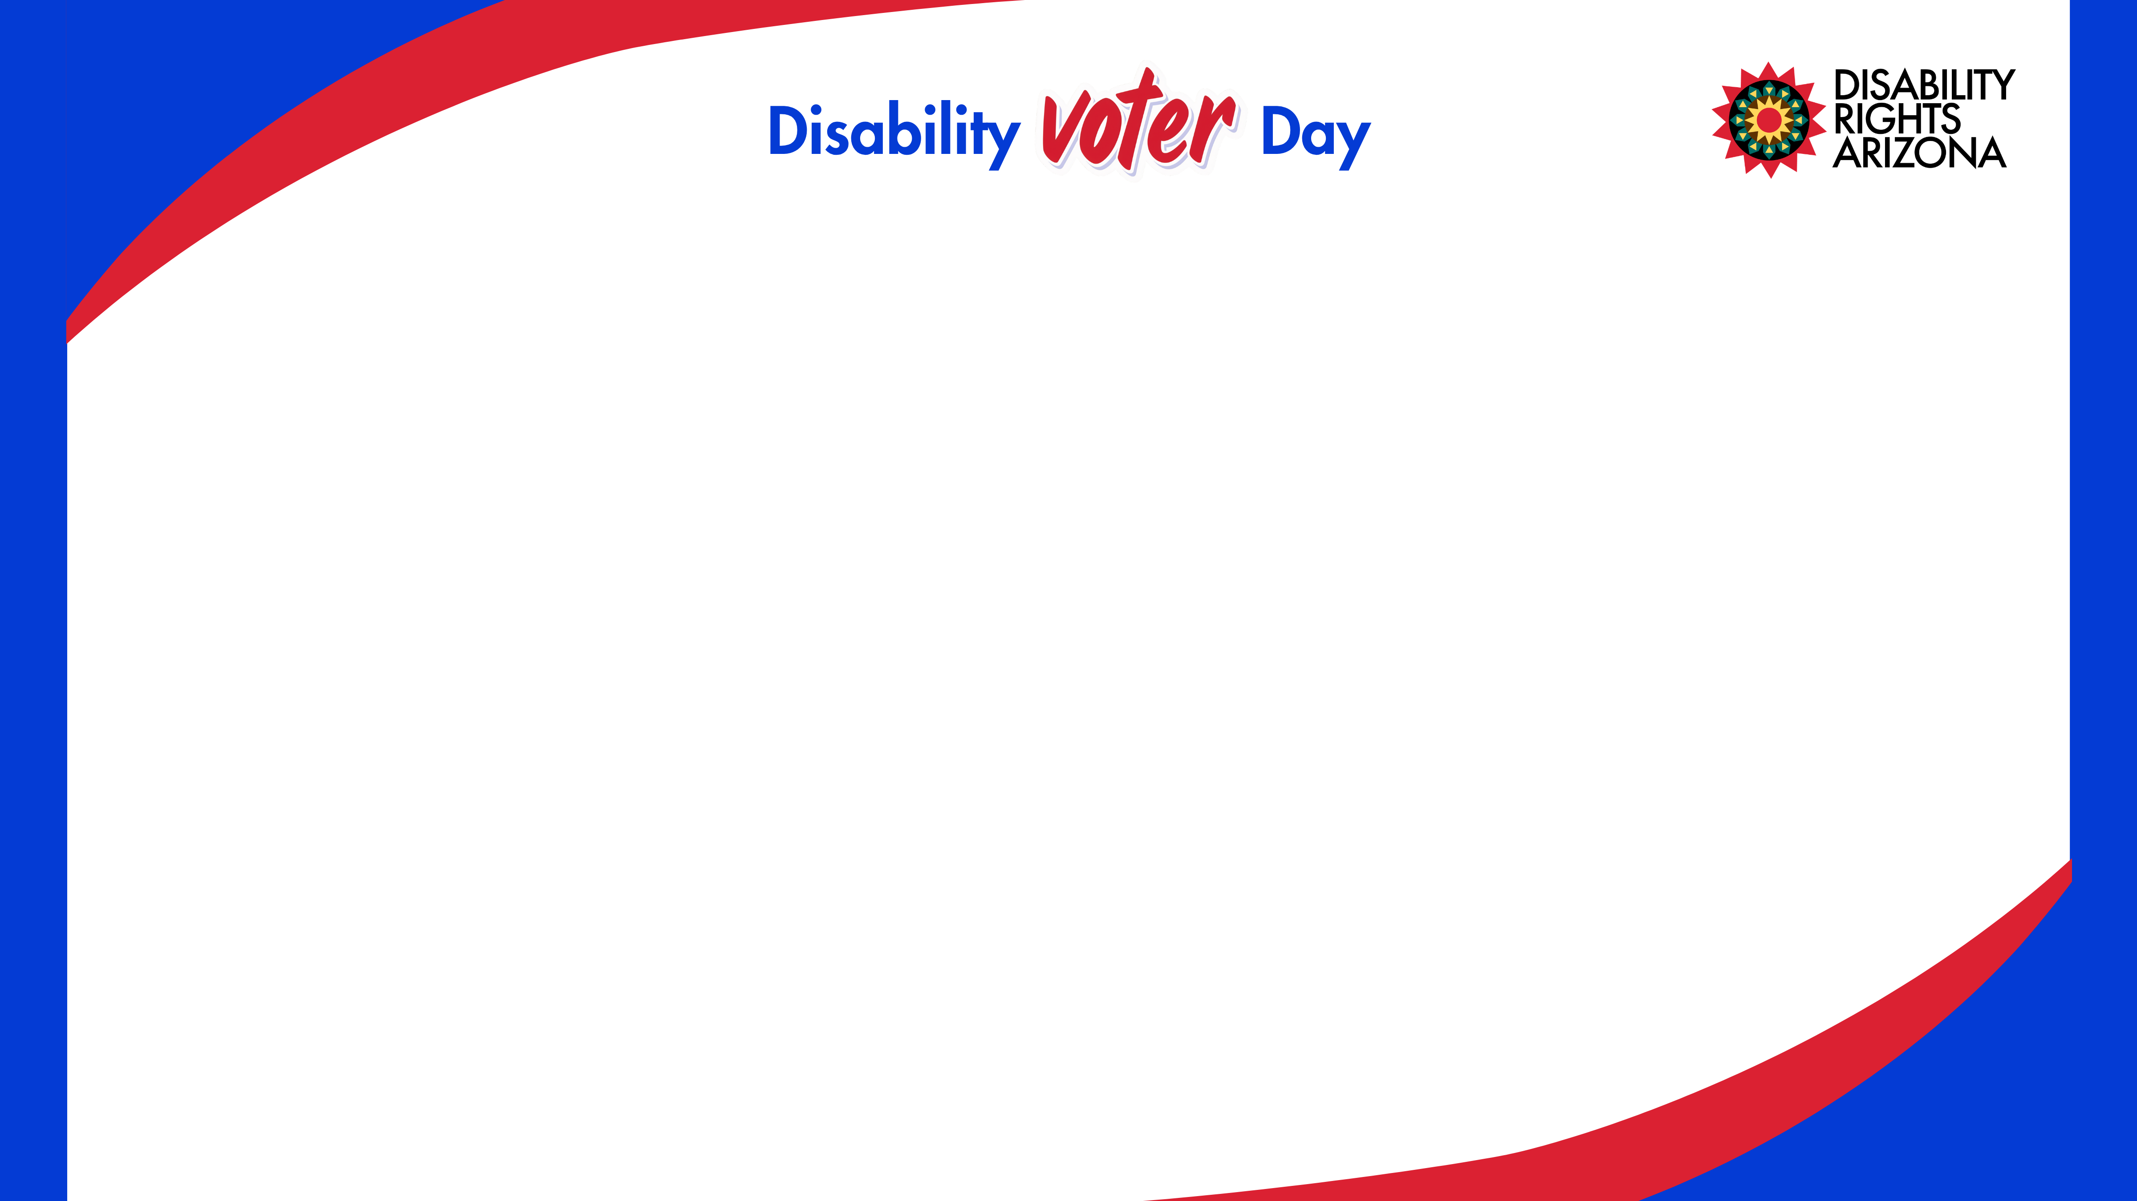
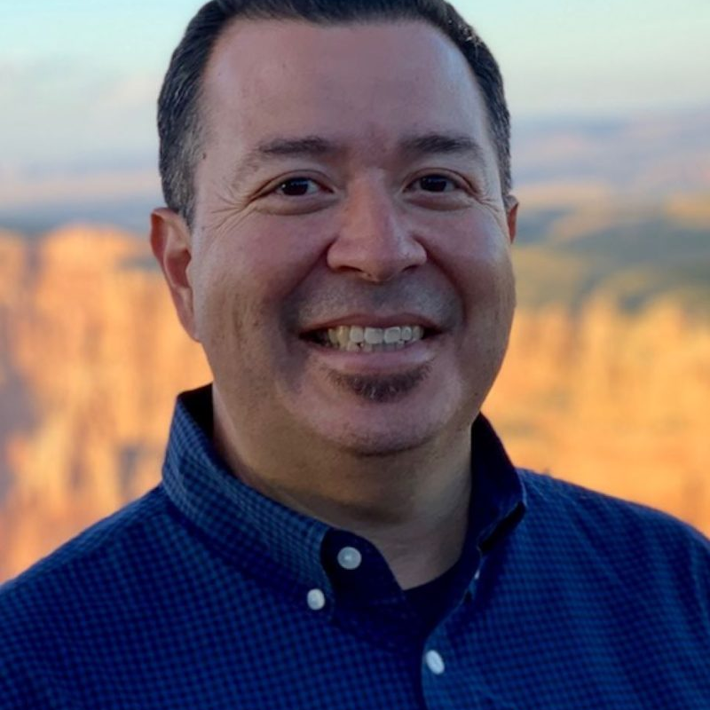
Opening Remarks and Welcome
J.J. Rico,
CEO,
Disability Rights Arizona

Slide 3
Housekeeping Rules
All sessions will be held in this room. Lunch will be served in the café across the courtyard. Restrooms are located down the hall to the right.
If you need to take a quick break, please feel free to use the courtyard, café or lobby.
Please be respectful to the speakers- if you need to take a call or engage in an extended conversation, please step out into the courtyard or lobby area.
Please speak slowly and wait for a staff person to pass you the mic. This allows or ASL and CART interpreters to keep up.

Slide 4
Brave Space Agreements
Listen to understand, not always to respond.
Address the idea, not the person.
No idea is too far out. Be open to new ideas.
Never be afraid to hold space for transformation (Dr. Amanda Kemp).
Silence does not mean agreement.

Slide 5
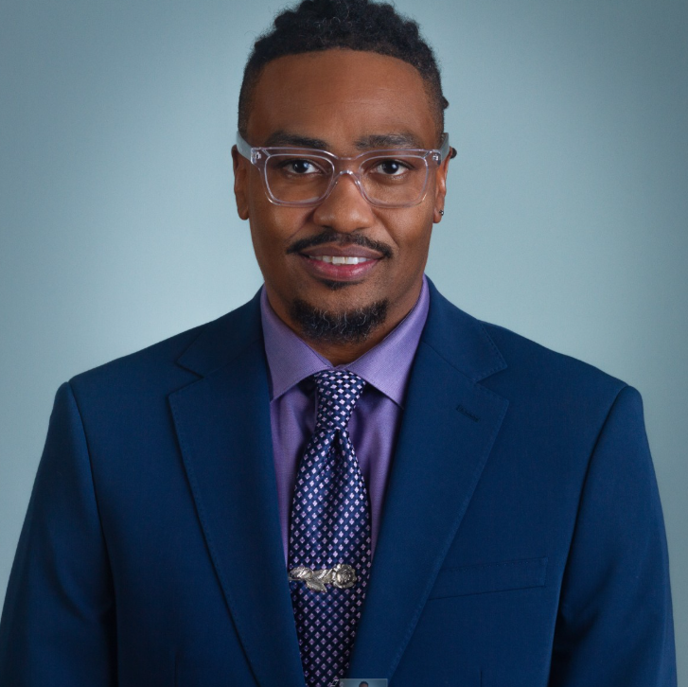

Session 1: The Role of Clean Elections in Arizona: Empowering Every Voter
Avery D. Xola
Voter Education Manager, Citizens Clean Elections Commission

Slide 6
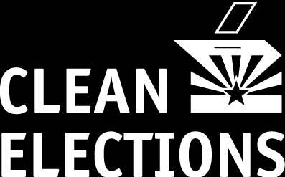
The Role of Clean Elections in Arizona: Empowering Every Voter
Presented by: Avery Xola, MPA

Slide 7
Why Clean Elections Cares About Voter Accessibility
It’s about equity and democracy.
People with disabilities make up a major part of Arizona’s voting community.
Even though access has improved, disabled voters still vote at lower rates than non-disabled voters.
These barriers are real, but they can be fixed.
Making voting accessible helps voters trust the election process.
Clean Elections has a responsibility to support voters and follow the law.

Slide 8
Key Data & Statistics from 2024
• About 14 out of every 100 of people in the United States have a disability.
• In Arizona, about 14 out of every 100 of people have a disability. That is more than 1 million Arizonans.
• In Maricopa County, about 9 out of every 100 of residents under age 65 have a disability.
• In Pima County, about 11 out of every 100 of residents under age 65 have a disability.
These numbers show why accessible voter education, clear election information, and voting options that work for different needs are important across Arizona.
Source: DisabilityStatistics.org and U.S. Census Bureau QuickFacts

Slide 9
What if every disabled voter in Maricopa or Pima County turned out?
10.5% of Pima County residents (about 155,000 people) have a disability; roughly 110,000 are of voting age.
In Maricopa County, about 8.6% of residents under age 65 have a disability. That is about 334,000 people, including roughly 247,000 voting-age adults.
That’s enough voters to shape any local election.
Source: Disabilitystatistics.org and U.S. Census Bureau QuickFacts

Slide 10
If every disabled voter turned out, they could have a major voice in close elections.
That could mean:
• Changing the outcome of a city council, school board, or county race
• Deciding whether a local ballot measure passes or fails
• Making candidates pay more attention to accessibility, transportation, health care, housing, and voter access
• Showing that voters with disabilities are a powerful voting community
Source: Disabilitystatistics.org and U.S. Census Bureau QuickFacts

Slide 11
“Think about someone you know with a disability. What makes it easier or harder for them to vote?”

Slide 12
Created by Arizona voters in 1998 to make elections fair, transparent, and accessible.
Run by a nonpartisan, five-member commission and not politicians.
What is Clean Elections?
Focuses on:
Voter education
Clean campaign funding to candidates who skip PAC and corporate money
Accountability in campaign finance

Slide 13
Why It Matters for Voters with Disabilities
Gives voters clear, nonpartisan information in different ways, like online, in print, in large print, and in formats that work with screen readers.
Helps every voter take part and have their voice heard.
Makes voting easier to understand by explaining when, where, and how to vote.

Slide 14
Why It Matters for Voters with Disabilities 2
Candidates who use Clean Elections funding can focus on talking with voters, not just raising money from donors.
Clean Elections can keep big money from having too much power in elections.
Voters with disabilities can get clear information to make their own choices.

Slide 15
Tools That Support Accessible Voting
Voter Education: Find your polling place, request accessible ballots, and see candidate statements.
Candidate Debates & Videos: Events include ASL interpreters and/or captioning.
Partnerships with local disability organizations to spread accessible voter education resources.
Clean Elections: Staff can answer questions about accessible voting options.

Slide 16
Arizona counties offer accessible voting options for voters with disabilities.
This may include accessible voting machines, help at voting locations, curbside voting where available, and other accommodations.
Voters should contact their County Recorder or county elections office to ask what options are available for their specific county and voting location.

Slide 17
Tools That Support Accessible Voting
Voter Education: Find your polling place, request accessible ballots, and see candidate statements.
Candidate Debates & Videos: All events include ASL interpreters and captioning.
Partnerships with local disability organizations to spread accessible voter education resources.
Clean Elections: Staff can answer questions about accessible voting options.

Slide 18
Clean Elections in Action
Voter Education Guides in large print and partnership with Sun Sounds audio for the visually impaired.
Inclusive Representation in Clean Elections Comics and in outreach campaigns
All voter education materials on azcleanelections.gov meet accessibility standards (screen-reader compatible, alt text, keyboard navigation, high-contrast options).
Provide voter guides and infographics using clear, concise text and visuals to support cognitive accessibility.

Slide 19
How Clean Elections Public Funding Helps
Candidates who use Clean Elections funding agree to run campaigns powered by voters, not corporations or PACs.
Gives voters with disabilities more influence through $5 contributions and community support.
It gives more people a fair chance to be heard, including disability advocates and people with different life experiences.

Slide 20
How You Can Get Involved
Visit azcleanelections.gov to learn about your candidates and accessible voting options.
Submit voter questions focused on disability issues for the Clean Elections debates at debates@azcleanelections.gov
Use your vote and your voice to encourage others in the disability community to register and participate.
Share resources from @AZCleanElections on social media.

Slide 21
In Arizona, some ballot measures come from lawmakers and may appear online earlier. Measures from the public usually appear later, after signatures are turned in and checked.
Key 2026 General Election Dates
• Last day to register to vote: October 5
• Early voting starts: October 7
• Last day to ask for a ballot by mail: October 23
• Mail your ballot back by: October 27
• Election Day: November 3

Slide 22
Questions / Discussion
Email us at CCEC@AZCleanelections.gov

Slide 23
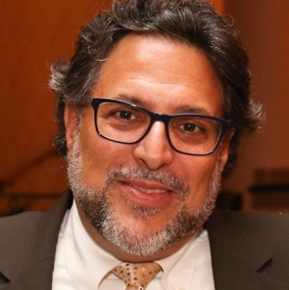
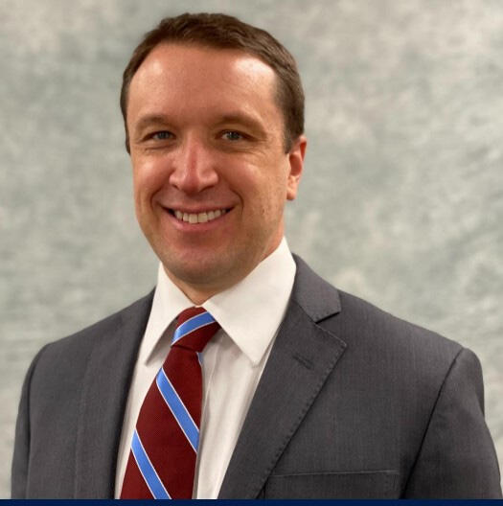
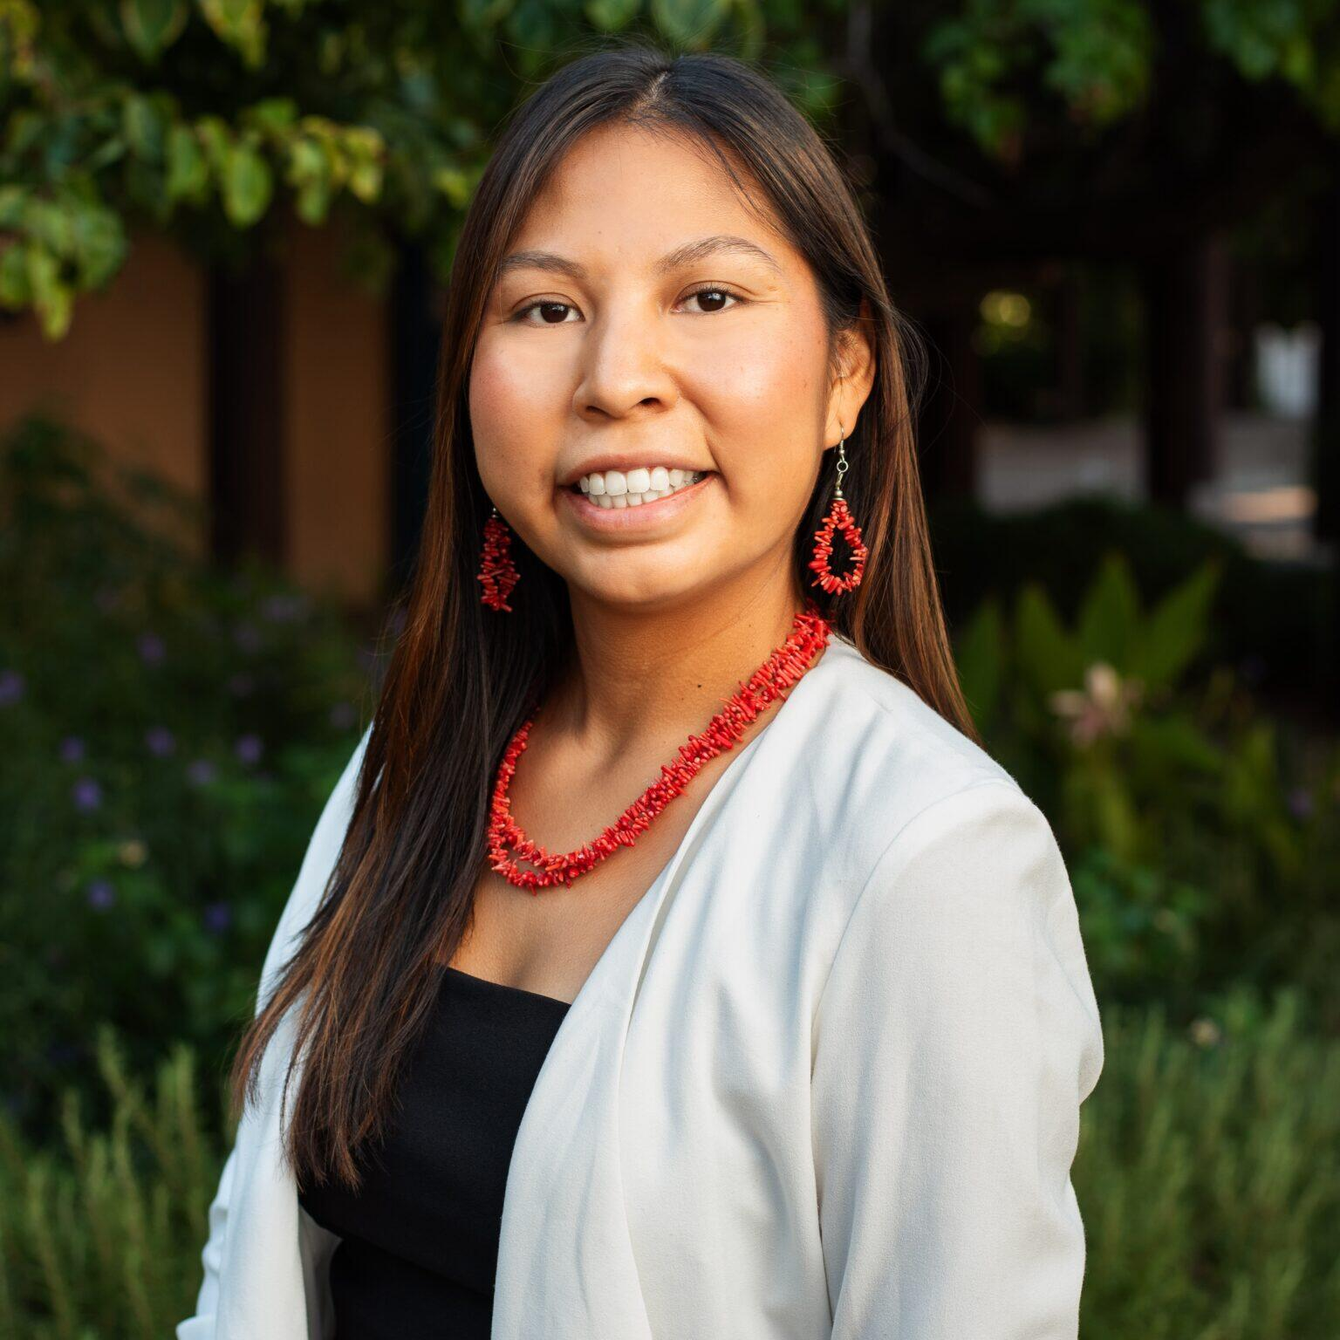
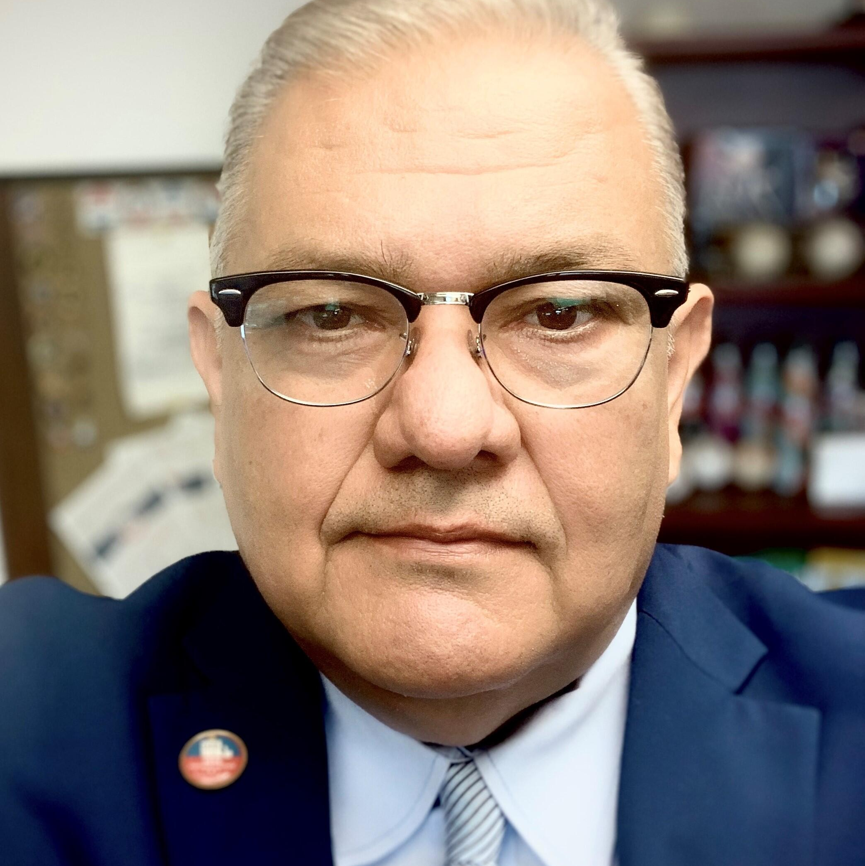


Session 2: Curbside Voting, Special Elections Boards, and Other Protections for Voters with Disabilities: A Roundtable Discussion
Panelists:
Alex Gulotta
Arizona State Director-
All Voting Is Local
Scott Jarrett,
Elections Director, Maricopa County Elections
Natalia Sells, Arizona Senior Campaign Manager-
All Voting Is Local
Rey Valenzuela, Director of Elections (Mail In Voting),
Maricopa County Elections

Slide 24
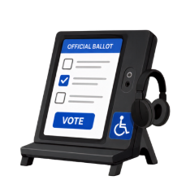
15 Minute Break
Visit Resource Tables and
Try Accessible Voting Machines

Slide 25
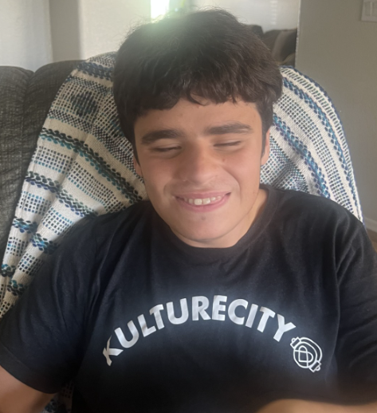
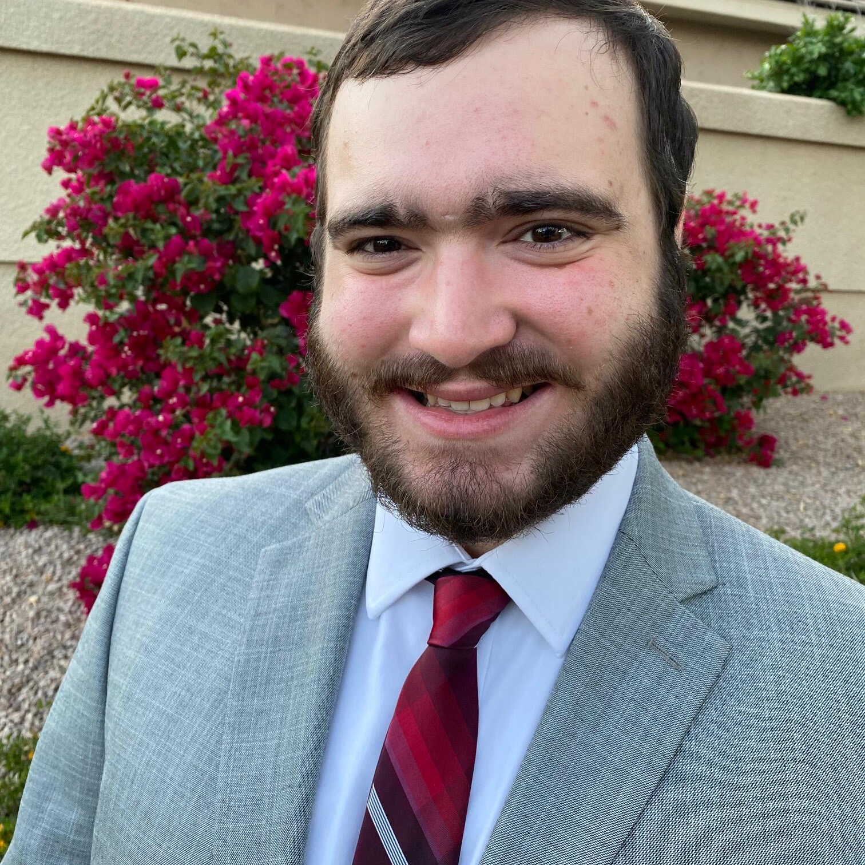
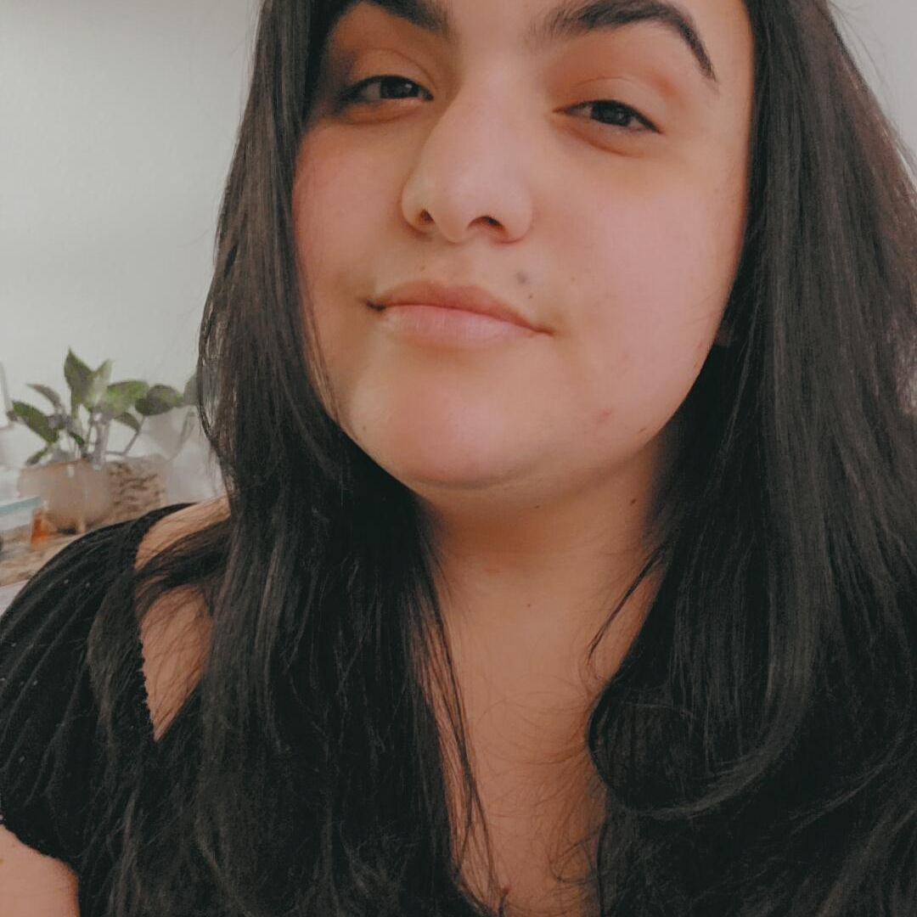
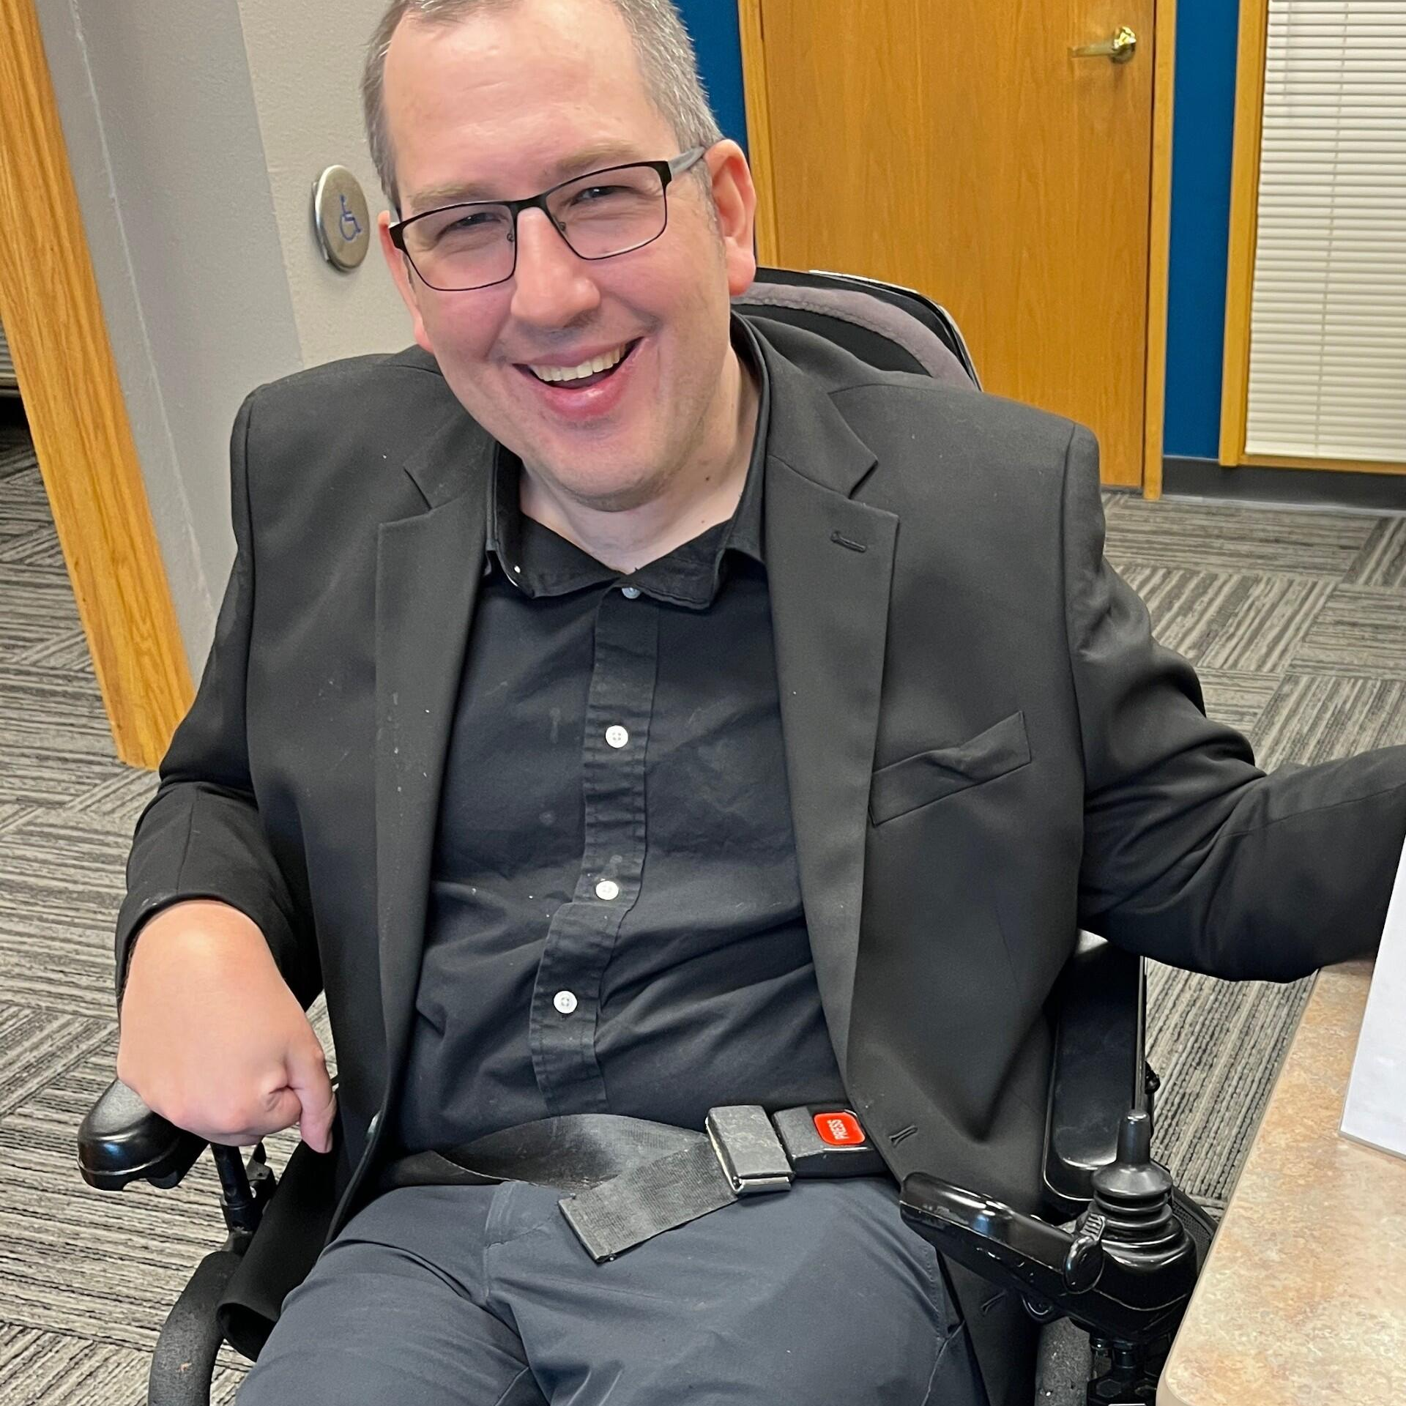
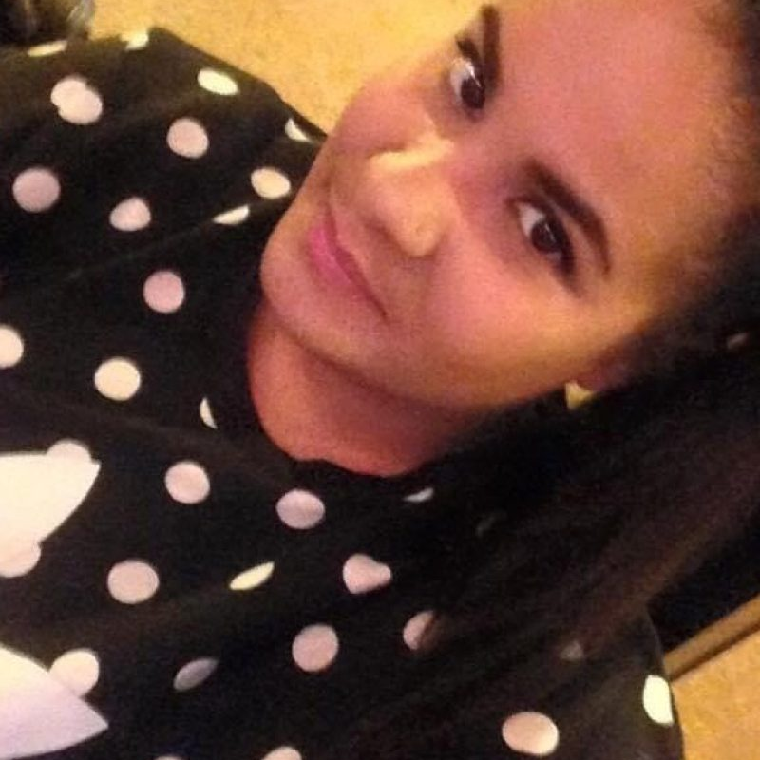


Get Out The Vote, Arizona!: Real Stories from Real Voters
Panelists:
Moderator:
Joe Giacinto
Tyler Haggerty,
Audra Paletta
Jason Snead
Jessie Barbosa

Slide 26
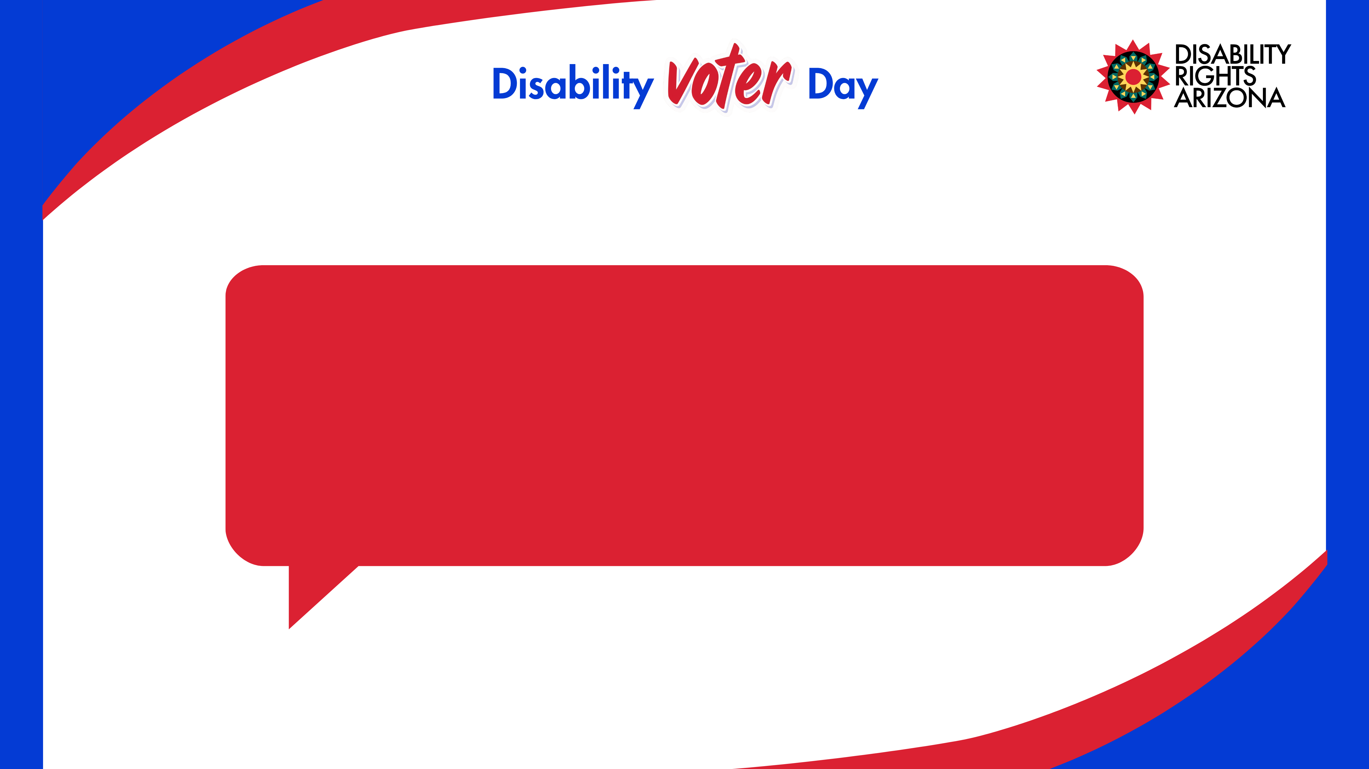
Please introduce yourself and share a fun or little-known fact about yourself.

Slide 27
Election Day is November 3rd-
Are you planning on voting?

Slide 28
What do you do to plan for Election Day? (example: do you research the candidates, do you request a mail-in ballot etc.?)

Slide 29
Why is voting important to you? What does it mean to participate in the electoral process as a person with a disability?

Slide 30
What issues are most important to you?

Slide 31
Any closing tips for voters with disabilities.

Slide 32
Questions for the Panel?

Slide 33
1 Hour Lunch Break
Visit Resource Tables and
Try Accessible Voting Machines

Slide 34

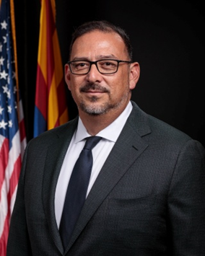
Keynote Session:
Protecting Our Right To Vote
By Mail
The Honorable Adrian Fontes,
Arizona Secretary of State

Slide 35
15 Minute Break
Visit Resource Tables and
Try Accessible Voting Machines

Slide 36
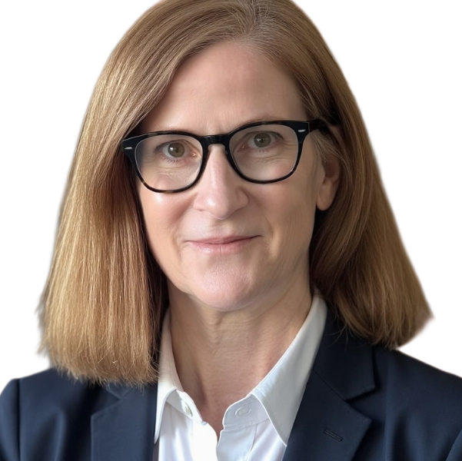
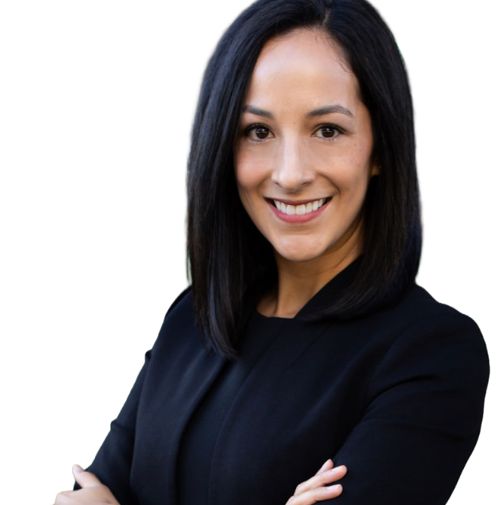

Session 5: Understanding Your Ballot: An Overview of Arizona’s 2026 Initiatives
Susie Cannata,
Founding Partner Tier 1 Strategy
Sabrina Vazquez
Founding Partner Tier 1 Strategy

Slide 37
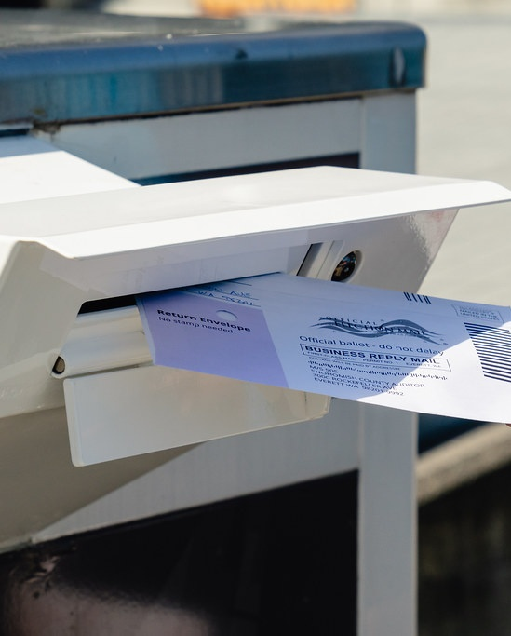
Arizona’s 2026 Ballot Measures
Disability Rights Arizona
Disability Voter Day
Susie Cannata & Sabrina Vazquez
Tier 1 Strategy
1

Slide 38

01
Initiatives vs. Referrals
Methods for placing measures on the Arizona ballot
02
History
Citizen initiatives have dramatically reshaped Arizona policies
03
Impact
Power of voter-protected policies and limits on funding
04
2026 Measures
What is on the ballot and what is at stake
2

Slide 39
Impact of Ballot Measures on Arizona Policy
1998
1981
1996
2000
2006
Medicaid/AHCCCS
Healthy Families
Protection on Voter-Approved Policy
Smoke-Free Arizona
A citizen initiative effort pushed the legislature to act. Arizona created AHCCCS in 1982.
Voter-approved measures expanded eligibility and funding for Medicaid services.
Voters prohibited smoking in most public places and workplaces, with specified exemptions.
Limits the legislature’s ability to amend, repeal or redirect voter-approved policies and funds.
2022
2010
2010
2022
2024
Medical Marijuana
Ban on Preferential Treatment
Limits on Content
In-State Tuition Eligibility
Arizona Abortion Access
Requires citizen initiatives to address only one subject.
Voters legalized marijuana use for qualifying debilitating medical conditions.
Prohibited state entities from granting preferential treatment or discriminating based on race, sex, color, ethnicity, or national origin for employment, education, and contracting.
Allowed qualifying Arizona high school graduates, regardless of immigration status, to receive in-state tuition and financial aid at public Institutions.
Established a constitutional right to abortion before fetal viability, with exceptions after viability to protect the pregnant individual’s life or health.

Slide 40
2026 Ballot Measures
The Legislature passed 10 Legislative referrals.
EDUCATION MEASURES
OTHER LEGISLATIVE REFERRALS
CHALLENGED IN COURT
Discrimination/
Preferential Treatment By
Government Entities
Vehicle Milage Tax
Prohibition
Prop 143
Labor Union Funding
Restrictions
Taken Off The Ballot.
Prop 142
Prop 141
Schools/Athletic Associations
Restroom Restrictions
Voter Identification/
Citizenship Voting
Requirements
Military Family
Scholarship Accounts
Taken Off The Ballot.
Prop 318
Prop 144
Prop 145
Prop 317
Prop 320
School District Spending
Prop 316
Grocery Tax Limit
Prop 212
Protect Education Act
Taken Off The Ballot.
Prop 317
Drug Cartels
Prop 319
Photo Traffic Enforcement
Systems
Navy is Legislative referrals
Green is Citizen initiatives
5

Slide 41
2026 Ballot Measures
WHAT IT DOES
SUPPORTERS ARGUE
Amends the Arizona Constitution to prohibit the state, counties, cities, towns, and other political subdivisions from charging taxes or fees based on motor vehicle miles traveled.
Supporters say it blocks a future mileage-based tax, protects driver privacy, and prevents government limits on personal travel. They frame it as a constitutional guardrail before mileage-tracking programs become common.
PROP 141
KEY DETAILS
Vehicle Milage
Tax
Prohibition
Prohibits the state, counties, cities, towns, municipal corporations, and other political subdivisions from imposing vehicle-mile taxes or fees.
Prohibits laws or rules that monitor or limit vehicle miles traveled unless the person voluntarily consents.
Exempts interstate agreements used to administer payment or reporting of fuel taxes or registration fees for commercial vehicles operating in more than one state.
Exempts motor vehicles owned and operated by the state, county, city, town, municipal corporation, or political subdivision.
Constitutional referral
OPPONENTS ARGUE
Opponents say it locks transportation policy into the Constitution and takes away a possible road-funding option as fuel-tax revenue changes. They argue local and state governments need flexibility for future infrastructure needs.
16

Slide 42
2026 Ballot Measures
WHAT IT DOES
SUPPORTERS ARGUE
Amends Arizona’s constitutional ban on preferential treatment and discrimination by adding new restrictions tied to race, ethnicity and certain public education or government practices.
Supporters say it strengthens equal-treatment protections and prevents the government from requiring race-based statements, programs, or discipline. They argue that public education and government employment should remain viewpoint neutral.
PROP 142
Discrimination/
Preferential Treatment
By Government Entities
KEY DETAILS
Prohibits public funding for offices or staff focused on race/ethnicity-based DEI initiatives in education.
Prohibits public spending on mandatory training related to race, ethnicity, or sexual orientation.
Prevents requiring employees or students to endorse preferential treatment based on race/ethnicity.
Prohibits student and employee disciplinary procedures from differing based on race or ethnicity.
Constitutional referral
OPPONENTS ARGUE
Opponents say the language could restrict diversity programs, anti-discrimination training, and classroom discussions about race and ethnicity. They argue that broad constitutional language may chill efforts to address unequal outcomes.
6

Slide 43
2026 Ballot Measures
ADDITIONAL KEY DETAILS
Does not prohibit:
The creation of sex-specific spaces or designations;
Actions necessary to establish or maintaining eligibility in a federal program if the action is limited to outreach, advertising, or communication and does not modify the evaluation or application criteria for an individual;
The use of qualifications that are based on tribal membership if the program was established to serve members of Native American tribes;
Data collection, advertising, and outreach;
Trainings or programs developed by an attorney to ensure compliance with an applicable court order or antidiscrimination law;
Identifying and discussing historical movements; and
The state from requiring the certification of the existence of an affirmative action plan that is not based on race or ethnicity.
PROP 142
Discrimination/
Preferential Treatment
By Government Entities
Constitutional referral
7

Slide 44
2026 Ballot Measures
WHAT IT DOES
SUPPORTERS ARGUE
Amends the Arizona Constitution to add citizenship, voter identification, on-site ballot tabulation, and campaign-finance requirements for Arizona elections.
Supporters say the measure strengthens election integrity through uniform voter ID, on-site tabulation options and constitutional limits on foreign election spending. They argue the rules will increase public confidence.
PROP 144
Voter Identification/
Citizenship Voting
Requirements
KEY DETAILS
Constitutional referral
Cites the measure as the Fast Election Results Act.
Specifies that only citizens may register and vote in Arizona elections.
Requires voters to present valid, government-issued identification before casting a ballot.
Gives all voters the option to have their ballot tabulated at their voting location.
Prohibits foreign nationals from contributing or spending money or anything of value to influence an Arizona election
Allows voters and the Legislature to enact voting laws that are rationally connected to a legitimate state interest.
Contains severability provisions.
OPPONENTS ARGUE
Opponents say the measure creates barriers for mail voters, narrows acceptable ID and places detailed election rules in the Constitution. They argue the new court-review standard makes it harder to challenge harmful election laws.
12

Slide 45
2026 Ballot Measures
WHAT IT DOES
SUPPORTERS ARGUE
Supporters say groceries are essential and voters should approve any new or higher food tax. They argue the measure protects household budgets and creates a statewide limit on local grocery taxes.
Limits the ability of cities, towns, and other taxing jurisdictions to impose or raise transaction privilege, sales, use, franchise taxes, or similar taxes on qualifying groceries.
PROP 316
Grocery Tax Limit
Statutory referral
KEY DETAILS
OPPONENTS ARGUE
Applies to food items intended for home consumption.
Blocks new or increased taxes between July 1, 2025, and June 30, 2027.
Afterward, voter approval is required, and increases are capped at 2%.
Jurisdictions already at 2% or more may not increase the rate.
Opponents say the measure overrides local control and limits revenue options for cities and towns. They argue local voters already elect local officials and that communities need flexibility to fund police, fire, roads and basic services.
15

Slide 46
2026 Ballot Measures
WHAT IT DOES
SUPPORTERS ARGUE
Declares drug cartels to be terrorist organizations under Arizona law and directs the Arizona Department of Homeland Security to use all lawful authority to address cartel threats.
Supporters say cartel activity affects border security, fentanyl trafficking and human smuggling. They argue Arizona should formally identify cartels as terrorist organizations and direct state homeland security resources toward the threat.
PROP 317
Drug Cartels
Statutory referral
KEY DETAILS
OPPONENTS ARGUE
Defines a drug cartel as an ongoing formal or informal association engaged in human smuggling, drug trafficking for profit, or other conduct defined as terrorism under Arizona law.
Opponents say the measure may be more symbolic than operational and could broaden immigration or criminal enforcement without adding clear tools. They also argue that federal law already governs foreign terrorist designations and asylum standards.
14

Slide 47
2026 Ballot Measures
WHAT IT DOES
SUPPORTERS ARGUE
Requires public and private schools and athletic associations that sponsor interscholastic or intramural athletics to designate teams as male, female or coed based on biological sex recorded at birth.
Supporters say the measure protects fairness in female athletics and privacy in sex-designated athletic spaces. They argue sex-based teams and facilities preserve competitive opportunities for girls and women.
PROP 318
Schools/Athletic
Associations
Restroom Restrictions
KEY DETAILS
Cites the measure as the Protect Girls’ Sports in Arizona Act.
Beginning January 1, 2027, applies to public schools, private schools and athletic associations that sponsor interscholastic or intramural teams.
Requires athletic teams to be designated male, female or coeducational based on the sex of participating athletes.
Prohibits athletic teams designated for females from being open to males.
Prohibits authorization to use athletic restrooms, locker rooms, shower rooms or similar private spaces not designated for the person’s sex.
Defines “sex” as biological status recorded at birth on the original birth certificate and creates a private cause of action for knowing violations.
Statutory referral
OPPONENTS ARGUE
Opponents say the measure discriminates against transgender students and creates legal risk for schools. They argue it politicizes student athletics and may force schools into sensitive enforcement decisions involving minors.
8

Slide 48
2026 Ballot Measures
WHAT IT DOES
SUPPORTERS ARGUE
Restricts state agencies and local governments from using photo enforcement systems to identify violators of excessive speed unless the system is covered by a contract implemented before December 31, 2026.
Supporters say automated traffic enforcement should operate only with voter approval. They argue photo enforcement affects drivers, fines, and privacy, so communities should decide whether systems stay in place.
PROP 319
Photo Traffic
Enforcement Systems
Statutory referral
KEY DETAILS
OPPONENTS ARGUE
Local governments with qualifying existing systems must ask voters for approval at the next regular general election.
If voters approve, authorization lasts 10 years and must be renewed every 10 years.
If voters reject continued use, the system must stop operating within 90 days after the election.
Opponents say the measure restricts local traffic-safety decisions and could remove tools used to reduce speeding and red-light violations. They argue that repeated elections add cost and uncertainty for local governments.
13

Slide 49
2026 Ballot Measures
WHAT IT DOES
SUPPORTERS ARGUE
Requires qualifying school districts to spend at least 60% of operational spending on direct instructional expenses as defined by the Arizona Auditor General.
Supporters say the measure pushes more dollars into classrooms and creates accountability for how districts use operational funding. They argue large districts should prioritize teachers, instruction and student-facing expenses.
PROP 320
KEY DETAILS
School Spending
Applies to districts with at least 7,500 students or districts operating in counties with more than 500,000 residents.
The Auditor General defines “direct instructional expenses” and “operational spending.”
Beginning FY 2027-2028, districts below 60% must increase direct instructional spending by at least 0.5% each year until compliant.
Districts may bank surplus increases above 0.5% for future compliance years.
Noncompliant districts lose Classroom Site Fund allocations in 25% increments, up to 100% after four or more years.
The Superintendent of Public Instruction may grant limited one-year waivers.
Statutory referral
OPPONENTS ARGUE
Opponents say a fixed percentage does not reflect differences in transportation, facilities, special education, safety, administration, or rural needs. They argue that cutting Classroom Site Fund dollars from noncompliant districts could hurt students.
11

Slide 50
2026 Election Timeline
Key General Election dates from the Arizona Secretary of State.
Oct. 5
Oct. 7
Nov. 3
Nov. 19
Nov. 23
Voter registration deadline
Early voting begins and early ballots mailed
General Election Day
County canvass deadline
Official statewide canvass
Unofficial results begin on election night. Final results take time as counties process ballots and canvass returns.
18

Slide 51
Questions?
20

Slide 52
Closing Remarks
J.J. Rico,
CEO,
Disability Rights Arizona

Slide 53





Stay Connected with DRAZ
https://disabilityrightsaz.org/
https://www.facebook.com/disabilityrightsaz/
https://www.instagram.com/disabilityrightsaz
https://www.youtube.com/channel/UCBAJ8Dn00GP_e-FC_9LwJ-g
https://www.linkedin.com/company/arizona-center-for-disability-law

